Slide 1



AGE 214: Lecture 5
Diode Applications I: Rectifiers
Sokoine University of Agriculture
AGE 214 - Lecture 5

Slide 2


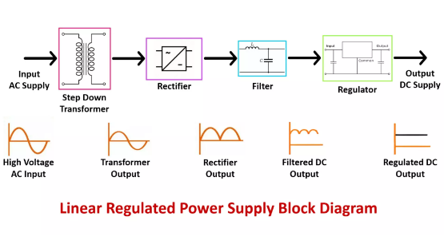
From AC to DC
The Power Supply Chain
Electronics need steady DC, but outlets provide AC. We use a 4-stage process:
1.
Transformer: Steps down 220V AC.
2.
Rectifier: Converts AC to pulsating DC (The Diode's Job).
3.
Filter: Smooths the pulses using capacitors.
4.
Regulator: Stabilizes the voltage.
Sokoine University of Agriculture
AGE 214 - Lecture 5

Slide 3
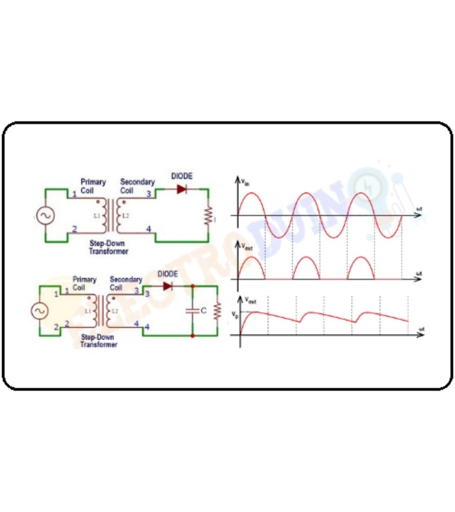
Half-Wave Rectifier
The simplest rectifier circuit.
•
Component: Single Diode in series with load.
•
Positive Cycle: Diode is Forward Biased (Switch ON). Current flows.
•
Negative Cycle: Diode is Reverse Biased (Switch OFF). Current blocked.
Note the input and output waveforms in the diagram.

Slide 4








Half-Wave Analysis
Average (DC) Voltage
We only use half the wave, so the average voltage is low.
Efficiency
Ripple
Frequency
Low. Negative cycle wasted.
High. Hard to filter.
fout = fin (50Hz)
Sokoine University of Agriculture
AGE 214 - Lecture 5

Slide 5

Full-Wave Rectification
Utilizing both halves of the AC cycle

Slide 6
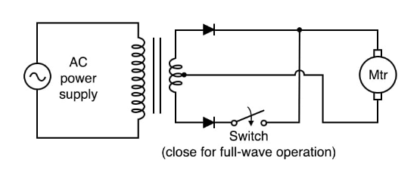
Method 1: Center-Tapped
Splitting the Phase
•
Uses a specialized transformer with a center tap (ground).
•
D1 Conducts: During positive half.
•
D2 Conducts: During negative half (which is inverted by the transformer).
•
Result: Two positive pulses per cycle.
Sokoine University of Agriculture
AGE 214 - Lecture 5

Slide 7
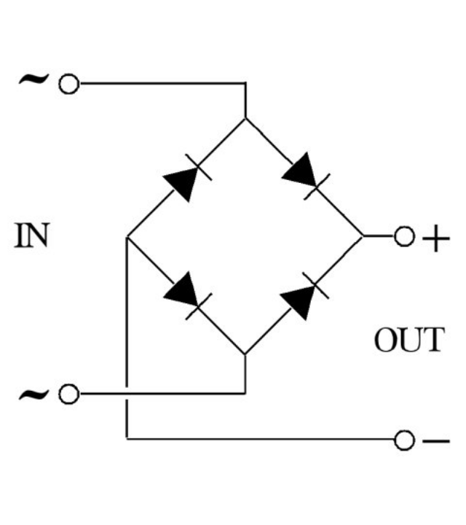
Method 2: Bridge Rectifier
The industry standard for power supplies.
•
Components: 4 Diodes in a diamond bridge configuration.
•
Advantage: No special transformer needed. Lower PIV rating for diodes.
•
Path 1: D1 & D2 conduct (Positive).
•
Path 2: D3 & D4 conduct (Negative).

Slide 8

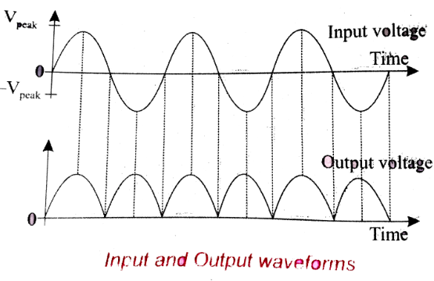


Full-Wave Output
Visual Analysis
Observe the output waveform:
•
No gaps between pulses.
•
The frequency has doubled.
•
The average voltage is much higher.
Sokoine University of Agriculture
AGE 214 - Lecture 5

Slide 9






Ripple Frequency
Input (AC)
Rectification
Output (DC)
Grid Frequency
Negative cycle flipped
Ripple Frequency
50 Hz
100 Hz
Higher frequency is easier to filter with smaller capacitors.
Sokoine University of Agriculture
AGE 214 - Lecture 5

Slide 10
Rectifier Comparison
Parameter | Half-Wave | Center-Tap FW | Bridge FW
Diodes | 1 | 2 | 4
Vdc | 0.318 Vm | 0.636 Vm | 0.636 Vm
Ripple Freq | fin | 2fin | 2fin
PIV Rating | Vm | 2Vm (Costly) | Vm (Good)
Sokoine University of Agriculture
AGE 214 - Lecture 5

Slide 11
Questions?
Next Lecture: Filters & Zener Regulators
Dr. Kadeghe Fue
Sokoine University of Agriculture
AGE 214 - Lecture 5

Slide 12





https://hackatronic.com/wp-content/uploads/2025/03/Linear-Regulated-Power-Supply-Block-Diagram.webp
Source: hackatronic.com
https://www.electroduino.com/wp-content/uploads/2021/04/What-is-Half-Wave-Rectifier-Working-Principle-Circuit-Diagram-Waveforms.jpg
Source: www.electroduino.com
https://www.allaboutcircuits.com/uploads/articles/full-wave-center-tap-rectifier-schematic-diagram-2.jpg
Source: allaboutcircuits.com
https://upload.wikimedia.org/wikipedia/commons/1/13/4_diodes_bridge_rectifier.jpg
Source: commons.wikimedia.org
https://d10lpgp6xz60nq.cloudfront.net/physics_images/PRE_GRG_PHY_XII_V02_C09_E01_022_S01.png
Source: www.doubtnut.com

